Slide 1


Introduction to Azure and how to start from scratch
November, 2018

Slide 2

Agenda
What is cloud?
Cloud providers and solutions
Microsoft Azure overview
Azure services
Pricing and subscriptions
Q&A

Slide 3
Classical hosting models
Shared Hosting
Dedicated Server
Virtual Private Server (VPS)
Virtual Dedicated Server (VDS)
Notes:
Shared Hosting
Dedicated Server
Virtual Private Server (VPS)
Virtual Dedicated Server (VDS)

Slide 4

What is Cloud?
Cloud is VPS on Steroids
On-demand self-service
Broad network access
Resource pooling
Rapid elasticity
Measured service
National Institute of Standards and Technology

Slide 5
Service models in a cloud
On Premises
Infrastructure
(as a Service)
Platform
(as a Service)
Software
(as a Service)
Applications
Applications
You manage
Applications
Applications
You scale, make resilient and manage
You scale, make
resilient & manage
Data
Data
Data
Data
Runtime
Runtime
Runtime
Runtime
Scale, resilience and management by vendor
Middleware
Middleware
Middleware
Scale, resilience and management by vendor
Middleware
O/S
O/S
O/S
O/S
Virtualization
Virtualization
Managed by vendor
Virtualization
Virtualization
Servers
Servers
Servers
Servers
Storage
Storage
Storage
Storage
Networking
Networking
Networking
Networking
Notes:
Infrastructure as a service (IaaS),
Platform as a service (PaaS)
Software as a service (SaaS) Mobile "backend" as a service (MBaaS) Serverless computing
Function as a service (FaaS)

Slide 6
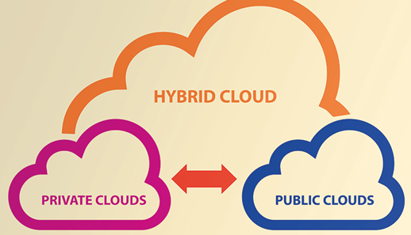
Types of cloud
Public cloud
The cloud provider keeps up the servers and data center equipment
Private cloud
A cloud system that sits isolated in a cloud provider’s datacenter or in your company’s datacenter.
Hybrid cloud
A hybrid cloud system uses elements of both a public cloud service and relies on a company’s legacy servers or private cloud system.

Slide 7
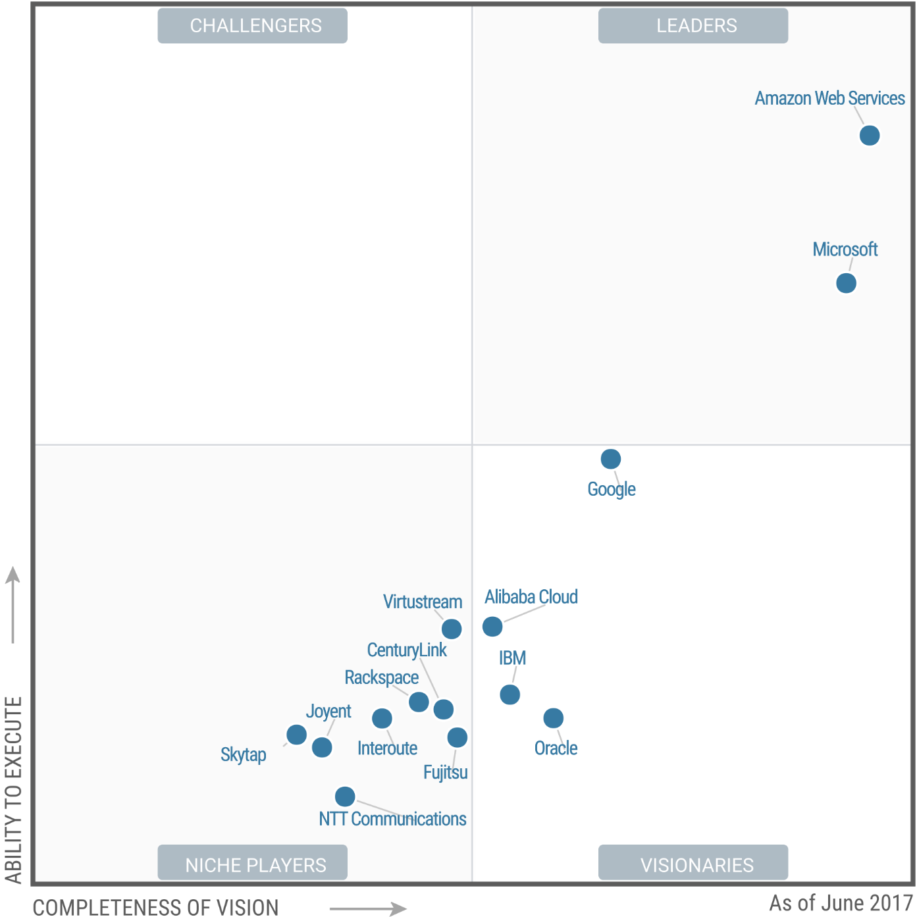
Cloud providers and vendors
2017
Amazon Web Services - AWS
Microsoft - Azure
Google – Google cloud
Alibaba Cloud
IBM
Oracle
Notes:
IaaS

Slide 8

Microsoft Azure overview

Slide 9
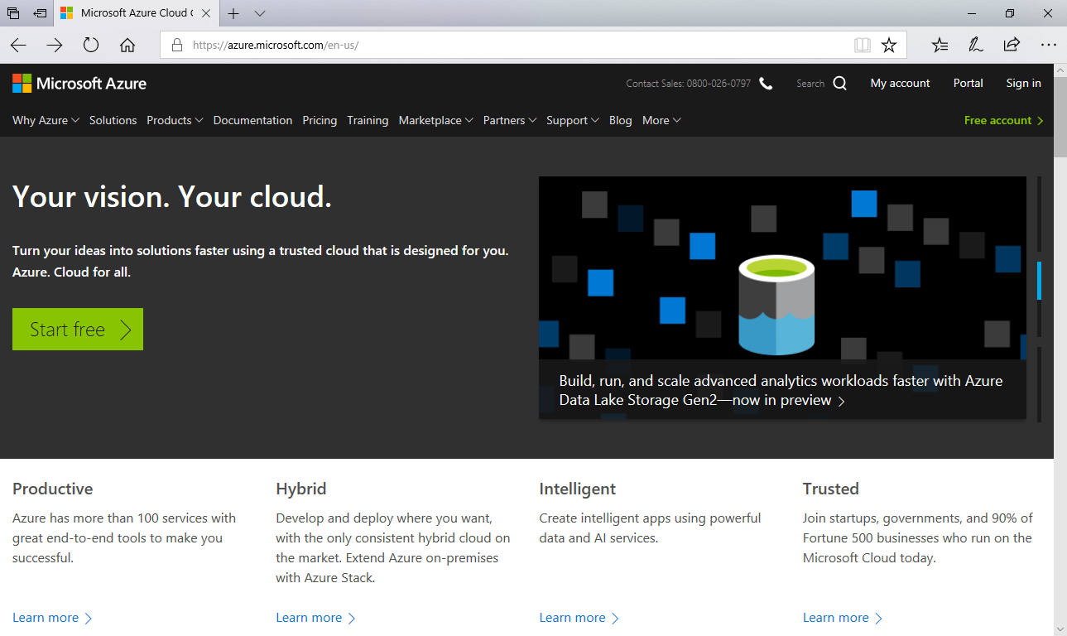
What is Azure
Azure is a set of cloud services and offerings from Microsoft
Azure provides next top benefits:
Decreasing Costs
Increasing Speed
Global Scale
Productivity
Performance
Security
Support for various software stacks and languages
https://azure.microsoft.com
https://portal.azure.com/

Slide 10
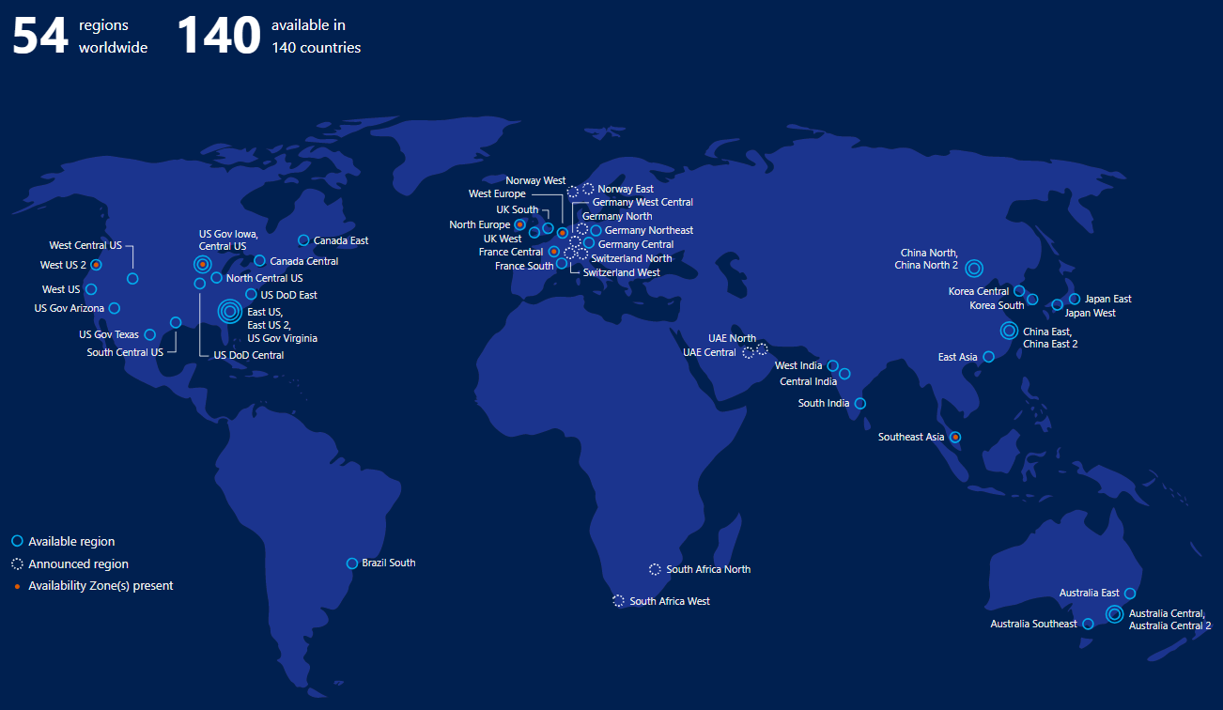
Azure regions

Slide 11
Azure services

Slide 12
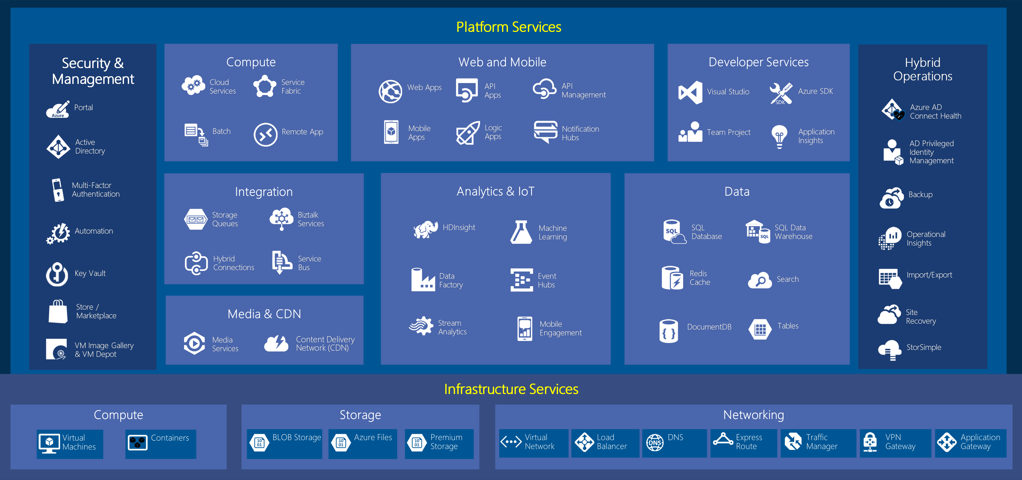
Azure Big Picture
Notes:
Over 100 services

Slide 13

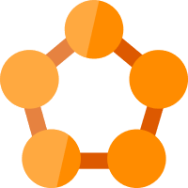







Compute
Containers /
Microservices
IaaS
Classical
Hosting
Serverless
Cloud Services
Container Registry
Function
Service Fabric
Virtual Machines
Web App
Container Instances
Azure Kubernetes
Service
(AKS)
Logical App

Slide 14










Data management and Analytics
RDBMS
No-SQL
Analytics
Azure SQL Database
HDInsight
SQL Data Warehouse
…
Storage: blob, table, queue, file
Azure Database for MySQL
Data Factory
Stream Analytics
Azure Cosmos DB
Redis Cache
Azure Database for PostgreSQL

Slide 15


Identity & Security
Synchronize your corporate and 3rd party identities
Integration with O365
Support modern protocols
OAuth 2.0
OpenID Connect
WS-Fed
SAML 2.0
Azure Active Directory
Multi-Factor Authentication
Azure Active Directory B2B & B2C

Slide 16






Integration and Internet of Things
Azure IoT Central
IoT Hub
Service Bus
Event Grid
Event Hubs
IoT Edge

Slide 17






AI + Machine Learning
Speech
Computer Vision
Machine Learning Studio
…
Text analytics
Face
Emotion

Slide 18




Network
Intelligent customer routing with Traffic Manager
Content Delivery Network
www.yourapp.com
VPN Gateway
Traffic Manager
Virtual Network

Slide 19




Developer and DevOps
Application Insights
API Management
Azure DevOps
Visual Studio App Center

Slide 20
Pricing and subscriptions

Slide 21




Azure Subscriptions
Free TRIAL
Sign up for free and get $200 to spend on all Azure services for 30 days + 12 month of support free services
Pay-As-You-Go
Competitive pricing. No minimums or commitments. Cancel anytime.
MSDN
Get started with Azure now using monthly credits included with your MSDN subscription ($50 per month)
BizSpark
These benefits include $150 monthly credits of Azure.

Slide 22
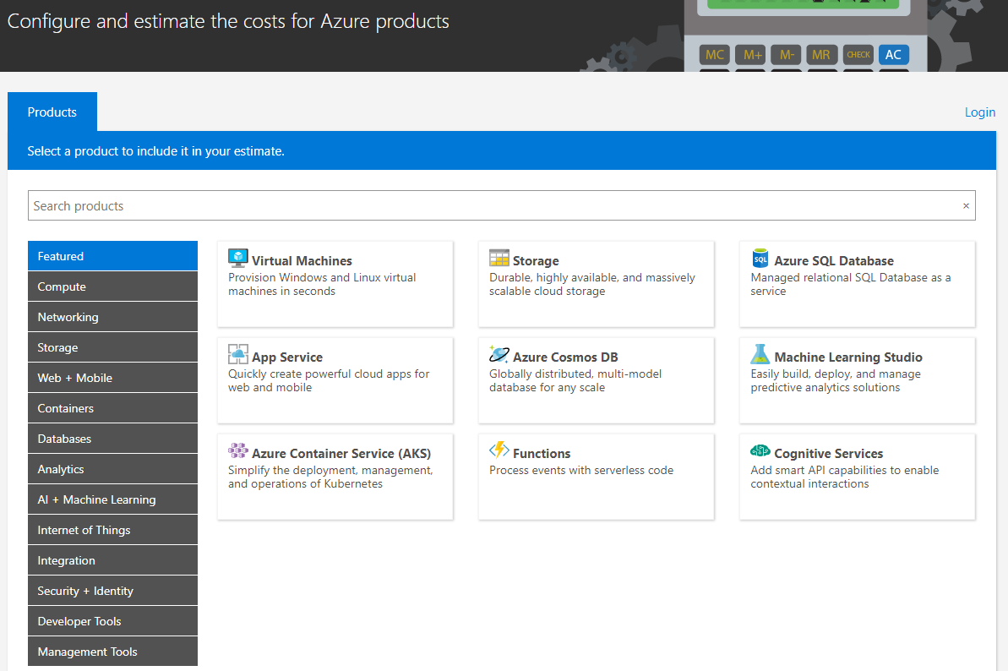
Azure calculator
You can select all products required by your solution
Configure pricing tiers of those products
Estimate the cost of your solution
http://azure.microsoft.com/pricing/calculator/

Slide 23
Azure portal

Slide 24
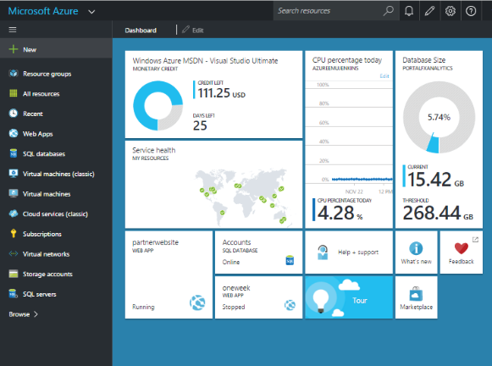
Azure portal
Resource and subscription management
Resource - item that is part of your Azure solution, such as web applications or databases
https://portal.azure.com/

Slide 25
Notes:
Pricing calculator

Slide 26

References
Azure documentation
MSDN article on Cloud development
Cloud patterns
Azure glossary
The Developer’s Guide to Microsoft Azure ^{SECOND EDITION}

Slide 27
Q&A
Saratov Azure Community:
Dmitriy Blokhin
Emails:
OrgAzureCommunitySaratov@epam.com
Dmitriy_Blokhin@epam.com

